Slide 1
St. Nicholas Library Procedures

Slide 2
Common Sense
1. Listen actively and use quiet voices in the library.
2. Choose “just right” books.
3. Treat everyone with kindness and respect.
4. Take care of our school, library and materials.
5. Follow directions the first time they are given.

Slide 3
Visiting the Library
Book Exchange
Library Cards
During Classroom designated times
Open Book Exchange (12:25- 12:55) Days 1-4
During Open Book Exchange
Mrs. Treptau will be available in the library to assist students in signing out books
Classrooms may send up to 4 students at a time.
Students are to find a book, sign it out, and return to class promptly.
All students will receive a duo tang with their library “card” on the front. This duo tang will be stored in the classroom.
Your duotang it important! It is – your library card, your shelf marker, and a collection of literacy records and reading strategies.
Your Library Card should be brought to the library during exchange times.

Slide 4
Checking out Books
• Students may check out TWO items at a time.
> Grades 2-8 – are allowed to take out ONE novel and ONE “other book” – graphic novel, non-fiction, magazine.
• Students may be given special permission from their classroom teacher to sign out additional materials for in class assignments and projects.
Returning Books
• Students are to place books in the return box.
• Items that are too large for the slot may be placed on the counter.

Slide 5
Student Responsibility
Overdue Material
Lost Material
Student materials will be loaned out for two weeks.
Students are encouraged to renew their overdue books. They may be renewed twice.
Classroom teachers will be provided with overdue reports on a monthly basis.
If you have one over-due book you may still take out one book. If you have two overdue books you may not sign out a new book from the library until you return the overdues.
After several attempts to collect overdue resources students will be given a letter to take home.
Students have the option to return materials or pay the replacement value.
“Lost” Letters will go out in December and June.

Slide 6
Caring for books!
Our books are BRAND NEW, which means we need to give them extra care and attention to keep them looking new.
• Students are responsible for caring for items.
• Use a bookmark (don’t fold pages)
• Students should let Mrs. Treptau know ASAP if they encounter a damaged resource.
• If a resource cannot be repaired the student may receive a fine notice to pay the replacement value.

Slide 7
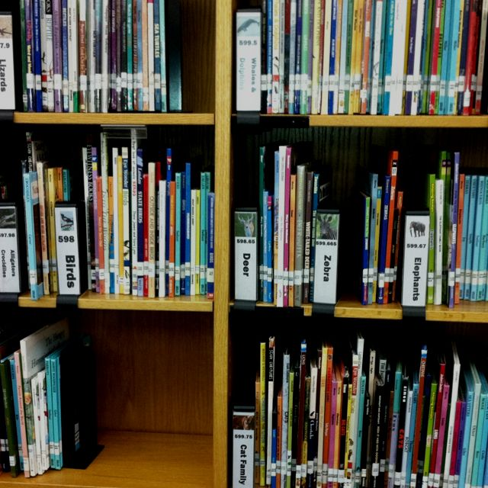
What is Genrefication?
This is the new way the library is organized.
Fiction Genres *Still shelved alphabetically by author’s name!
Non-Fiction Genres *No numbers, books are just placed into their labelled sections.
What about the “E” books?

